Slide 1
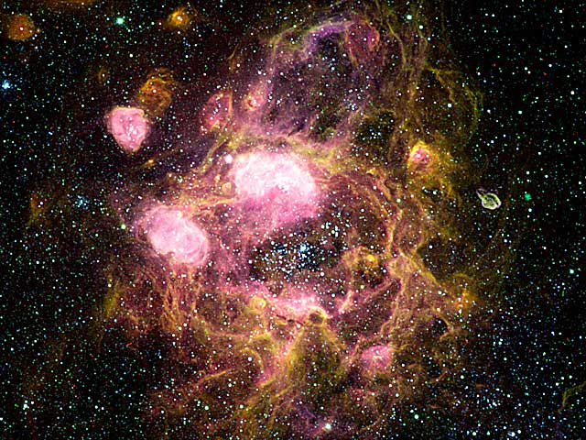
The Infinite Space
Created by Kurt Burgess

Slide 2
So the adventure begins
You are on a space ship light years away from home, you see a neiboring spaceship sending you a distress call.
You ignore the distress call and continue your journey.
Accept the distress call and go to the ship to investigate.

Slide 3
You ignore the distress call and continue your journey.
Oh well that could have been a trap but where is your sense of adventure why not try it again?
Try again ☺

Slide 4
So the adventure begins ONCE AGAIN
You are on a space ship light years away from home, you see a neiboring spaceship sending you a distress call.
You ignore the distress call and continue your journey.
Accept the distress call and go to the ship to investigate.

Slide 5
You accept the distress call
You now board on to the ship,
As you check for any life on the ship you hear a noise coming from the left corridor.
And a dark shadow from the right corridor.
Keep scanning
Investigate the left corridor
Investigate the right corridor

Slide 6
Keep scanning
As the noises get louder and louder your scanner tells you that there are over a 100 unknown creatures.
So what should you do?
Investigate the left corridor
Get your guns from your ship!!!
Investigate the right corridor

Slide 7

Investigate the right corridor

Slide 8
Investigate the left corridor

Slide 9
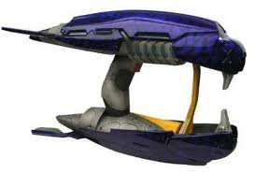


Get your guns from the ship!!!
Choose your gun:
Plasma gun
Stoner 63
Ray gun

Slide 10
Now that you have your gun
Now that you have you r gun:
Go through the left corridor
Go through the right corridor

Slide 11
Investigate the right corridor with guns
Now you have your gun you go down the right corridor and end up at a hatching are for the aliens who have take over the ship.
BUT WAIT!!
One of the mother aliens has seen you.
What do you do.

Slide 12
Investigate the left corridor with guns

